Slide 1
Processing In Xilinx Devices
Adam Taylor

Slide 2
Session 1
Session 2
Session 3
Session 4
Introduction to Xilinx FPGA
Processing in Xilinx FPGA
Embedded Linux
Accelerating Solutions

Slide 3







Processing in FPGA is not new
Quad A53 MPCore
1.5 GHz 13800 DMIPS
Dual A72
Dual A9 MPCore
1 GHz 5000 DMIPS
Performance
7nm
Dual 440 Cores 550+ MHz 1100+ DMIPS
16nm
Dual 405 Cores 450+ MHz 700+ DMIPS
28nm
405 Core
300+ MHz 450+ DMIPS
65nm
MicroBlaze – 32-bit Soft Processor
90nm
130nm
2001 2003 2005 2007 2012 2015 2018

Slide 4
Hard and Soft Processor Cores

Slide 5
Hard Processors In Xilinx
Cortex-A72 64-bit three way Out of Order Superscalar Application Processor which implements the Armv8-A architecture. Performance wise the Cortex-A72 cores can achieve up to 4.72 DMIPS/ MHz with clock rates up to 2.5 GHz per core.
Cortex-A53, 64-bit Superscalar Application Processor which implements the ARMv8-A architecture. Performance wise the Cortex-A53 cores can achieve up to 2.24 DMIPS / MHz with clock rates up to 1.5 GHz per core.
Cortex-A9, 32-bit Superscalar Application Processor which implements the ARMv7-A architecture. Performance wise Cortex-A9 cores can achieve up to 2.5 DMIPS / MHz with clock rates up to 1 GHz per core.
Cortex-R5 / R5SF, 32- bit processor designed for Real Time Safety Critical Applications which implements the ARMv7-R architecture. Performance wise the Cortex-R5 cores can achieve up to 1.67 DMIPS /MHz with a maximum clock rate of with clock rates up to 600 MHz per core.

Slide 6
Hard Processors In Xilinx

Slide 7
Hard Processors in Xilinx
The ability to change the entire or partial contents of the programmable logic as the application demands. This enables much easier in the field updates as standards evolve or even allows for different programmable logic designs to be loaded at different parts of the application.
Power Efficient operation, the processors can be powered down into low power modes and the programmable logic can be powered down. This enables the system to be able to offer solutions which scale power demand with use cases.
Security the processing system contains all of the necessary infrastructure to provide the confidentiality, integrity and authentication of the application thanks to AES, SHA and RSA algorithms
Safety, the decoupling of the processing system and programmable logic enables safety solutions to be implemented using diverse approaches which with careful design do not contain a single point of failure.

Slide 8
Soft Processors in Xilinx
MicroBlaze – 32-bit Reduced Instruction Set Computer (RISC) offered by Xilinx. MicroBlaze is offered in three configurations Microcontroller, Real Time and application offering 1.1 DMIPS/MHz, 1.3 DMIPS /MHz and 1.4 DMIPS/MHz respectively.
ARM Cortex M1 & M3 32-bit processors based on the Arm Arch V6 and Arm Arch V7 respectively. The Cortex M1 offers 0.8 DMIPS/MHz while the Cortex M3 offers 1.25 DMIPS/MHz
RISC-V is not actually a processor itself but an Instruction Set Architecture which enables development of open source processors which are compliant with the RISC-V ISA. As such there are several providers of RISC-V cores for implementation in programmable logic. With each implementation providing a different solution. The SiFive E31 RISC-V implementation offers between 2.58 and 1.61 DMIPS/MHz

Slide 9
Soft Processors benefits
Soft processors are tightly coupled with the programmable logic.
The programmable logic device is the master, it must be configured first to implement the soft-core processor. Once the soft-core processor is implemented within the programmable logic can the processor then boot its application.
Depending upon the size of the application the soft-core processors application may be contained entirely within Block RAMS provided by the programmable logic. This removes the need for an external non-volatile memory for the SW application.
As the processor is located within the programmable logic it is not possible to change the contents of the programmable logic at run time. However, it is possible to use partial reconfiguration and reconfigure regions of the programmable logic as required
Power Management does not have the ability to power down the programmable logic, however techniques such as clock gating and switching to slower clock frequencies for the remaining logic elements.
While we cannot easily implement a single device implementation which is free from single points of failure. However, we can very easily implement triple modular redundancy soft processor implementations with voting and synchronisation

Slide 10
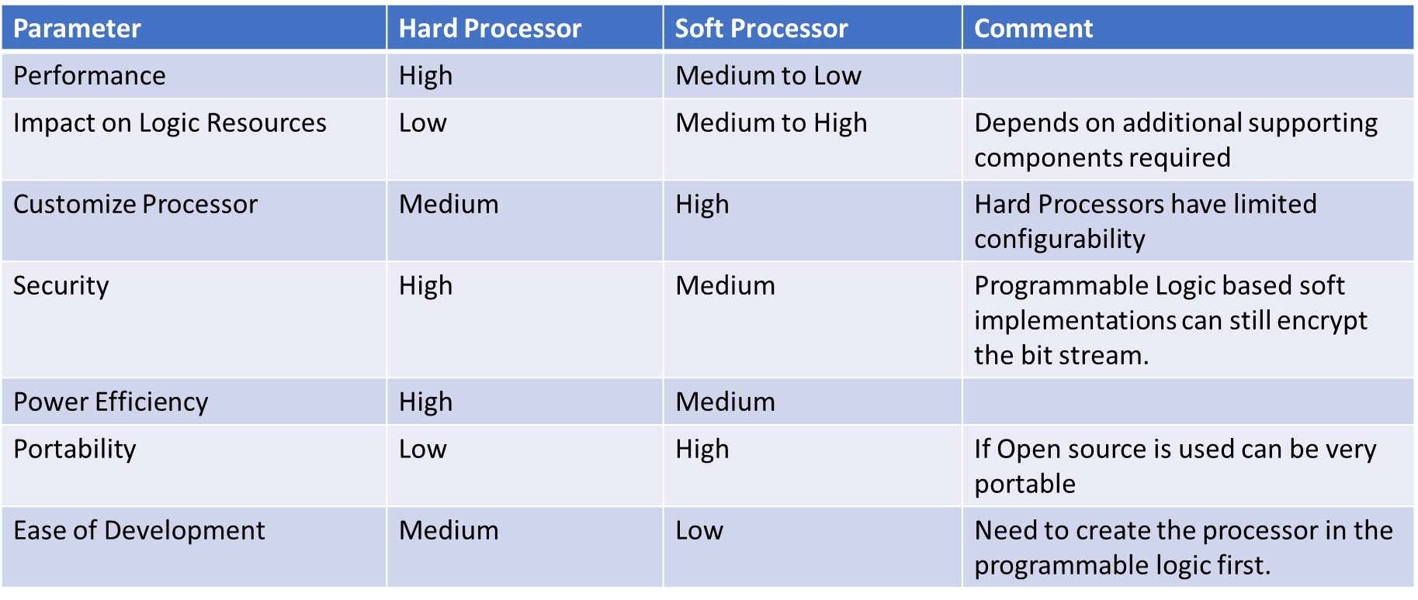
Which One Should I use?

Slide 11
Processing Solutions

Slide 12
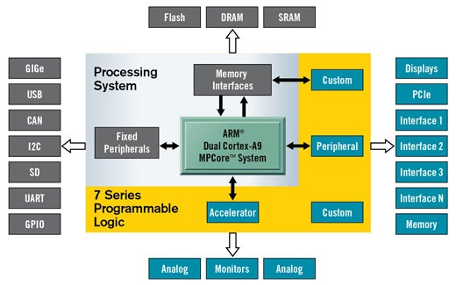
ZYNQ PS In Detail
Dual Core Arm Cortex A9 processors
Memory Controller – DDRx and SMC
Peripherals
Gigabit Ethernet, USB, UART, SPI, IIC, CAN, GPIO
Secure Boot – AES, RSA and SHA

Slide 13
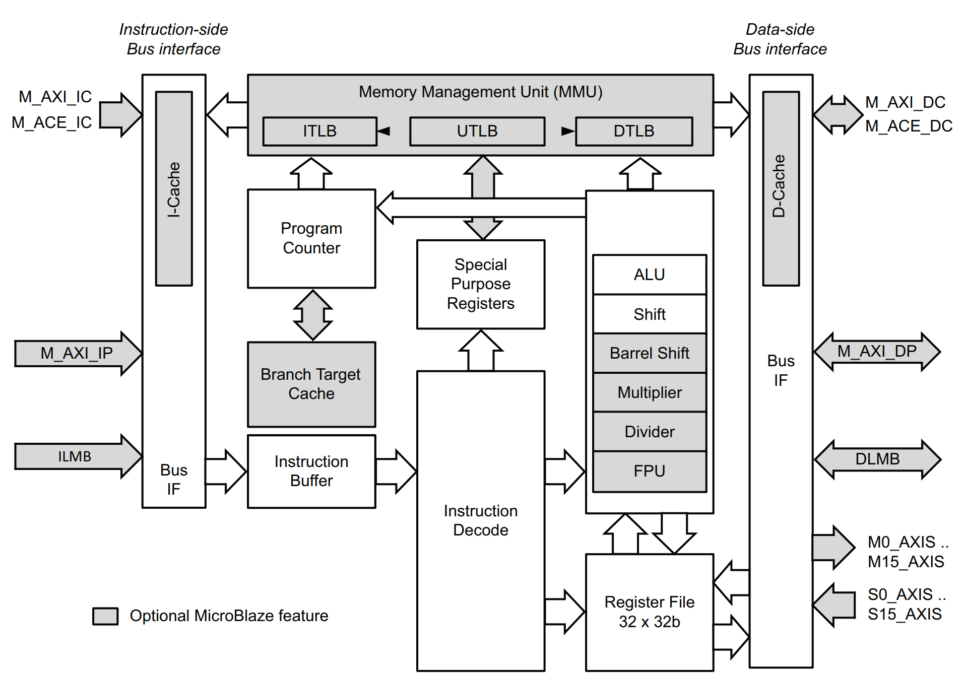
MicroBlaze
(Mostly) softcore processor
Harvard Architecture
Scalable from small micro to running Linux
Performance scales with configuration options
Can be implemented in TMR solution (very useful for high rel)

Slide 14
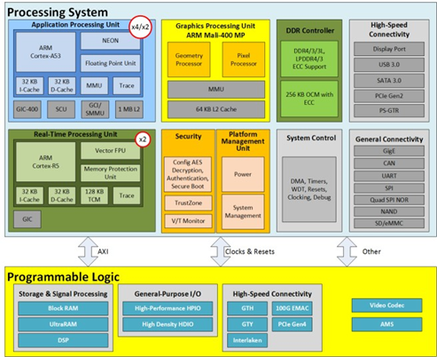
Introduction to Heterogeneous SoC
Processing System (PS)
Boots first
Contains processors, fixed peripherals, clocks, memory, and memory controllers
Dedicated silicon limited configurability
Programmable logic (PL)
Based on UltraScale architecture logic Details available in other topic clusters and documentation
Contains dedicated silicon resources: DSP48e, block RAM, high-speed serial, XADC, PCIe core, etc.
Interconnects
AXI based
Clocks and Resets
Other
Notes:
Other include Interrupts PS->PS PL->PS, Debug, EMIO

Slide 15
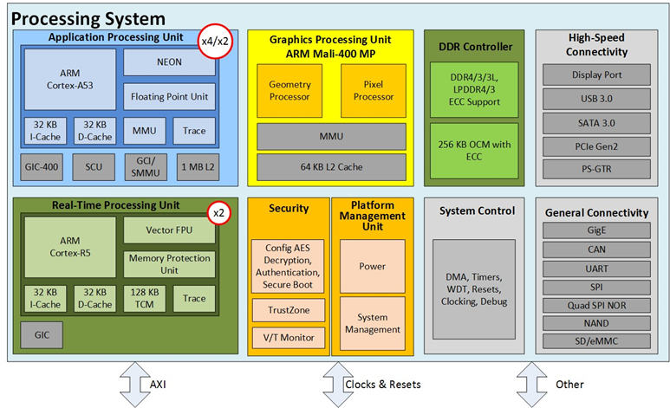
MPSoC /RFSoC PS in detail
Quad/dual-core ARM Cortex-A53 processor cluster
Dual-core ARM Cortex-R5 real-time processor cluster ARM Mali-400MP graphics processor
Memory controllers (DDRx and SMC)
Peripherals
High-speed peripherals: USB 3.0, SATA 3.0, PCIe Gen 2
technology, DisplayPort
Low-speed peripherals: CAN, UART, I2C
Security, power management, safety, and reliability

Slide 16
Key Concepts of Processing Systems

Slide 17
Processors in FPGA
Range of elements which make for a more responsive solution in our processing solution.
Clocking - What clock frequency and what Conversion is needed
Memory – Internal or external memory required
On Chip Memory – Application can execute from here normally limited size
Cache – Closely coupled memory used to increase performance by caching external RAM data
Interfacing – How do we interface / add peripherals to our processing system

Slide 18
Processors in FPGA
On Chip Memory – Memory connected to the processors from which applications can be executed.
Limited in Size but maybe all that is required for some applications
Can be used for security e.g. Trust Zone or Secure Boot
Cache – The cache structure will vary depending upon the complexity of the programmable SoC.
Each processor will have its own small level one (L1) instruction and data cache.
Processors will be connected to a larger level two cache (L2) for sharing data between processors.
More advanced options include Cache Coherent Interconnects (CCI) are provided these allow the design elements within the PL to be Cache Coherent

Slide 19
Processors in FPGAs
Interfaces – The programmable SoC will be required to interface with several different commonly used interface standards.
Range from SPI, UART and I2C designed to interface with other devices and sensors to more complex higher speed links such as Gigabit Ethernet and PCIe.
Typically, a programmable SoC will provide IO bank (s) which can be connected to one of the several supported IO standards. This enables the Programmable SoC processing system to be optimal in its use of IO standards, unused IO standards do not need to be routed out allowing maximum flexibility.

Slide 20
Operating systems
The simplest applications will use a bare metal development.
Bare-metal developments contain no operating system. Xilinx supplies several Application Processing Interfaces (API’s) and libraries which can be used to interact with the elements in both the processor and connected peripherals.
This board support package will need to be regenerated each time the design is updated to include or remove new elements.

Slide 21
Operating System
For more complex applications an operating system is used, the type of OS selected will depend upon if a real time response is required or not.
If a real time response is required, then an operating system such as FreeRTOS or Micrium OS/III may be required.
If a real time response is not required but the application requires working with high level frameworks and networking, then embedded Linux is always a popular OS choice

Slide 22
Operating System
What differentiates a real time operating system from one which is not?
An RTOS is deterministic. That means the response of the system will meet a defined deadline
Hard RTOS – Missing a deadline is classified as a system failure.
Firm RTOS – Occasionally missing a deadline is acceptable and is not classified as a failure.
Soft RTOS – Missing a deadline simply reduces the usefulness of the results.

Slide 23
Multiprocessing and Hypervisors

Slide 24
Multiprocessing and Hypervisors
Deploying multi processors is called multiprocessing
At the highest-level Multiprocessing is broken down into two distinct groups depending upon how the processors and the operating systems are combined.
Symmetric Multi-Processing - In a SMP application, all processors and resources are under the control of a single operating system.
Asymmetric Multi-Processing – In an AMP application, multiple operating systems are used on different processors cores. All operating systems share the same physical system memory.

Slide 25
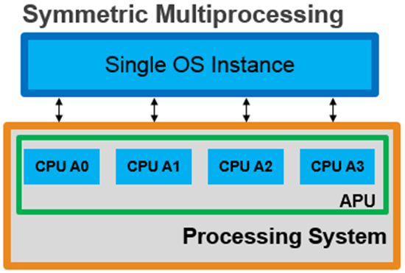
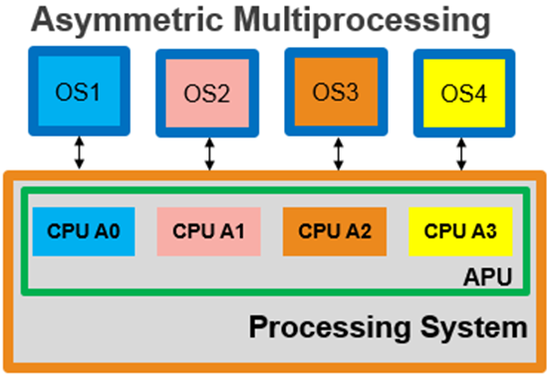
Multiprocessing and Hypervisors

Slide 26
Multiprocessing and Hypervisors
Using an AMP approach allows the programmable SoC or FPGA to get the best of both worlds combining real time operating systems and application operating systems such as Linux.
The choice of AMP or SMP is not dependent upon if the SoC is homogeneous or heterogeneous.

Slide 27
Multiprocessing and Hypervisors
How do we communicate between different cores, running different OS?
OpenAMP
OpenAMP provides the framework for different operating systems to communication and manage lifecycles as required
When OpenAMP is used within a programmable SoC a typical deployment would be a Linux operating system managing the lifecycle and establishing the communication channels with other cores running different operating systems for example bare-metal or FreeRTOS

Slide 28
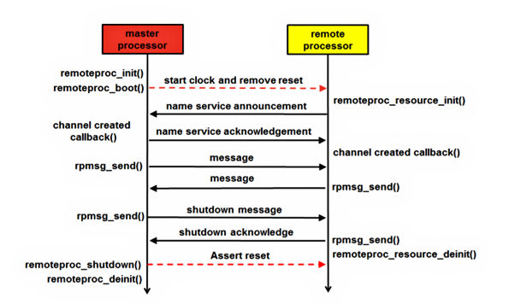
OpenAMP Overview
Key elements of the OpenAMP framework which enable this are
VirtIO – Virtualization, which allows communication with the network and device drivers
RemoteProc – This is the API that controls the remote processor. It starts and stops the execution, allocates resources, and creates the virtIO devices. This API performs what is often termed the Life Cycle Management (LCM) of the remote processor
RPMesg – The API that allows inter-process communication between the master and remote processor

Slide 29
Is OpenAMP always suitable ?
If we use an OpenAMP approach on a programmable SoC each operating system has potential access to the entire system resources and memory.
For some applications which are safety or security critical this is may not be acceptable, as such we need a different approach.
In this instance a hypervisor is often used.

Slide 30
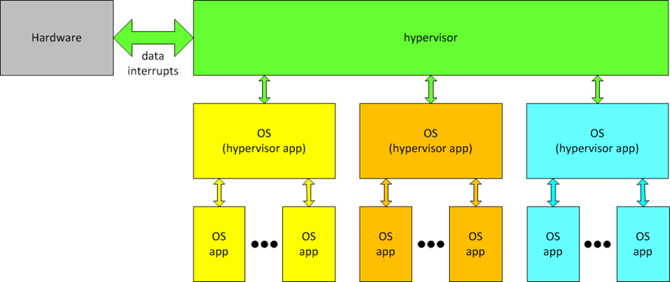
Hypervisor
A hypervisor sits between the processor cores and several different virtualised operating systems.
Due to how a hypervisor functions each operating system running on the hypervisor believes it is the only operating system running on the hardware

Slide 31
Hypervisor
Using a hypervisor enables the developer to allocate resources and enable access to system resources only as required. This provides for increased robustness and security in the end application.

Slide 32
Arm eXtensible Interface

Slide 33
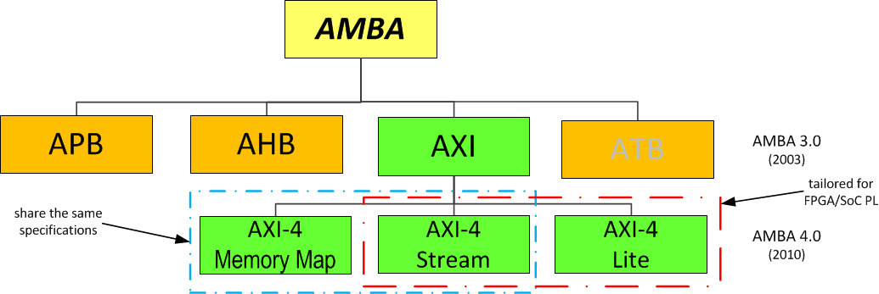
AXI is Part of AMBA: Advanced Microcontroller Bus Architecture
1
- 1
2
Interface | Features
Memory Map / Full | Traditional address/data burst (single address, multiple data)
Streaming | Data only, streaming
Lite | Traditional address/data—no burst (single address, single data only)
Notes:
Since the release of Zynq-7000, ARM announced the AXI4 spec. It is similar to AXI with three sub-interfaces to better target system specifications for performance and programmable logic usage. • Memory Map: The traditional AXI3 address/data/control line interface with improvements such as larger data burst length phase. • Stream: Targeting streaming applications to the same address. The transaction address phase has been removed. The focus is on high-performance data streaming. • Lite: A simple interface, reducing programmable logic requirements, targeting peripherals in address space that only require a single data phase.

Slide 34
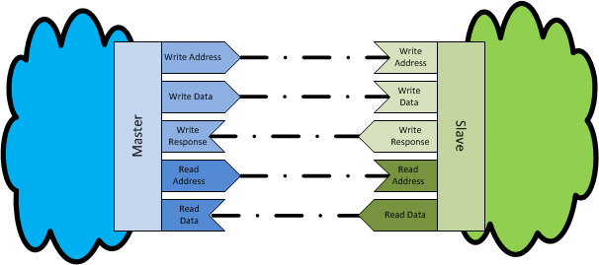
What is AXI
AXI is Advanced eXtensible Interface
—
Separate address, control, and data phases Support for unaligned data transfers
Burst-based transactions
Issuing of multiple outstanding addresses
Easy to close timing with addition of register stages
—
—
—
—
Interconnect and protocol specification
—
Describes how two devices connect
The AXI specification describes an interface on a piece of IP
—
It does not specify how systems of IP will be connected

Slide 35
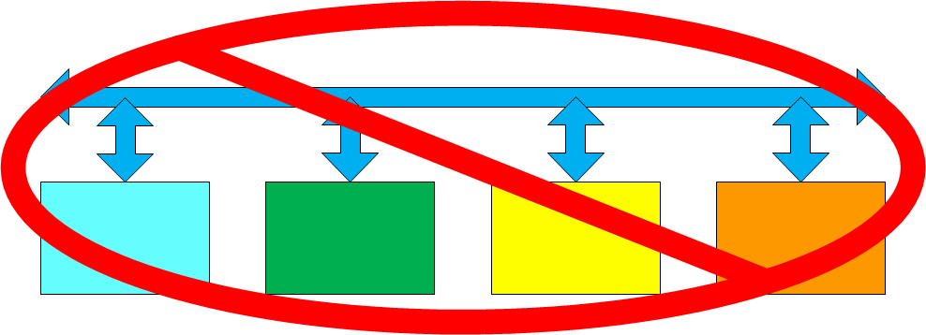
What is AXI Not
AXI is not a bus
Buses can be
multi-tap/drop; AXI is only point-to-point
AXI is not an electrical specification
No discussion of voltages or other physical requirements

Slide 36
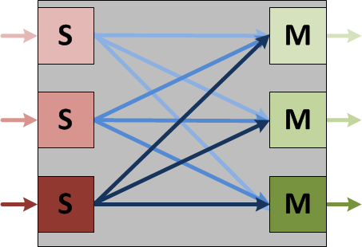
AXI Connections
AXI is a point-to-point protocol
—
One master port talks to only one slave port
This does not mean that one master device can talk to multiple slave devices, or vice versa
Special IP is used to augment AXI to support a full hierarchy
—
Crossbar: connects one or more similar AXI full masters to one or more slaves
Interconnect: similar to a crossbar, but provides for different clocks and resets
1
- 6
—

Slide 37
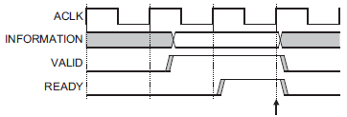
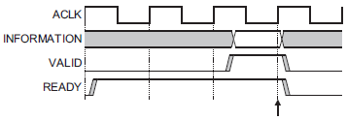
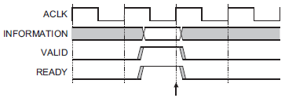
AXI Channel Handshake Basics
AXI uses a valid/ready handshake acknowledge
Each channel has its own valid/ready
Inserting Wait States
—
Address (read/write) Data (read/write) Response (write only)
—
—
Flexible signaling functionality
Always Ready
—
Inserting wait states Always ready
Same cycle acknowledge
1-
3
—
—
Same Cycle Acknowledge

Slide 38
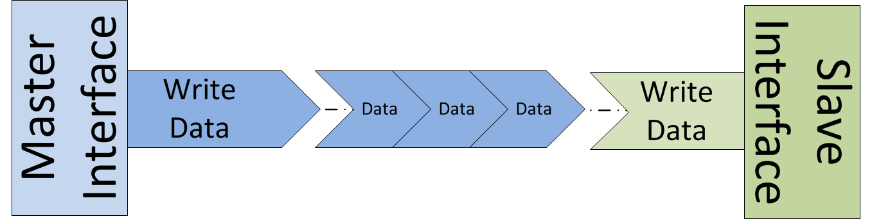
AXI Stream
Data moves in a single direction, from a master to a slave
Simplex communication: master-to-slave
Dual direction would be dual simplex; individual channels, for example
Data only
No address channel Minimum control Unlimited burst length
Sideband signals optionally used to condition data Contents of data stream interpreted by slave

Slide 39
MicroBlaze

Slide 40
MicroBlaze
Xilinx Softcore processor
32-bit / 64-bit RISC Microprocessor
Highly Configurable – implemented in logic fabric
Three pre-configured solutions provided by Xilinx
Microcontroller – Suitable for BareMetal developments
Real Time – Intended for real time applications using a RTOS e.g. FreeRTOS
Application – Embedded Linux (PetaLinux)

Slide 41
MicroBlaze Detail
AXI Interfaces enable connection to range of interfaces
SPI / I2C
Interrupt Controllers
DDR
Ethernet
Lockstep and TMR support
Performance depends on implementation & Fabric of course
Microcontroller 1.04 DMIPS/MHz
Realtime & Application 1.31 DMIPS/MHz
Spartan-7 Fmax Microcontroller 178MHz, Real Time 155 MHz, Application 120 MHz
Kintex US Fmax Microcontroller 393 MHz, Real Time 280 MHz, Application 242 MHz

Slide 42
MicroBlaze Development
MicroBlaze Defined using Vivado
Instantiate and configure the MicroBlaze
Add in peripherals to interface with the external world
If necessary, we can implement HLS / RTL IP cores for specialist accelerations
Merge Bitfiles – if external memory is not used
Simulation of the design – V important for TMR configuration
Implement hardware level debugging – ILA and VIO
Software created using Vitis
Application software development
Board Support Package creation – Pulls in API / Drivers for all IP cores in Vivado
Boot File creation
SW Debug – Memory, Breakpoints, Watch points, etc.

Slide 43
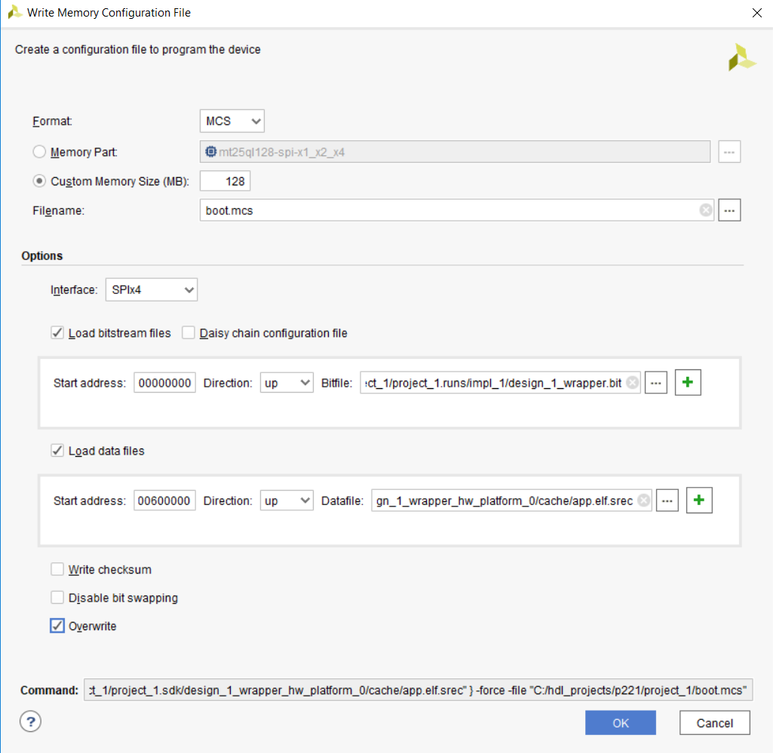
MicroBlaze Boot
Boot Options
Merge the ELF file with the BlockRAM in tightly coupled memories
External memory – Contains application
Merge Srec-Boot Loader
Vitis will create the Srec Boot Loader
Vivado used to program merge Srec Boot Loader and program the QSPI
Possible to store both the FPGA image and SW application in the same QSPI

Slide 44
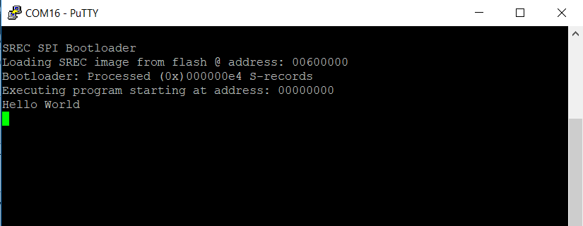
MicroBlaze External Boot Flow
Create Design in Vivado
Include QSPI
Update Configuration Settings
Create Bootloader in SDK
Configure QSPI Device settings
Generate Bootloader ELF
Program QSPI device using Vivado
Merge Bitstream with Bootloader ELF
Generate MCS with merged bitstream and application ELF
Create Application in SDK
Generate Application ELF
Boot MicroBlaze

Slide 45
Introduction to Arm Cortex-M1/M3

Slide 46
Cortex-M1 & M3 Architecture
Both Cortex-M1 and M3 architectures offer:
32 bit processor
Arm Arch V6 (M1)
Arm Arch V7 (M3)
Designed for low power, low foot print, low interrupt latency
Communication with peripherals
32 Bit hardware multiplier if desired
Debug Access Port – JTAG / Serial Wire access
Forward Binary Compatibility
M1 core implements a subset of the M3 instruction set and features

Slide 47
Optional Features
M1 Options
M2 Options
Debug access to all memory and registers in the system, including the processor register bank when the core is halted
Debug Access Port (DAP)
BreakPoint Unit (BPU) for implementing breakpoints
Data Watchpoint (DW) unit for implementing watchpoints
Memory Protection Unit (MPU).
Flash Patch and Breakpoint (FPB).
Data Watchpoint and Trace Unit (DWT).
Instrumentation Trace Macrocell Unit (ITM).
Embedded Trace Macrocell (ETM).
Advanced High-performance Bus Access Port (AHB-AP).
AHB Trace Macrocell interface (HTM interface).
Trace Port Interface Unit (TPIU).
Wake-up Interrupt Controller (WIC).
Debug Port Debug Port AHB-AP interface.
Constant AHB control.

Slide 48
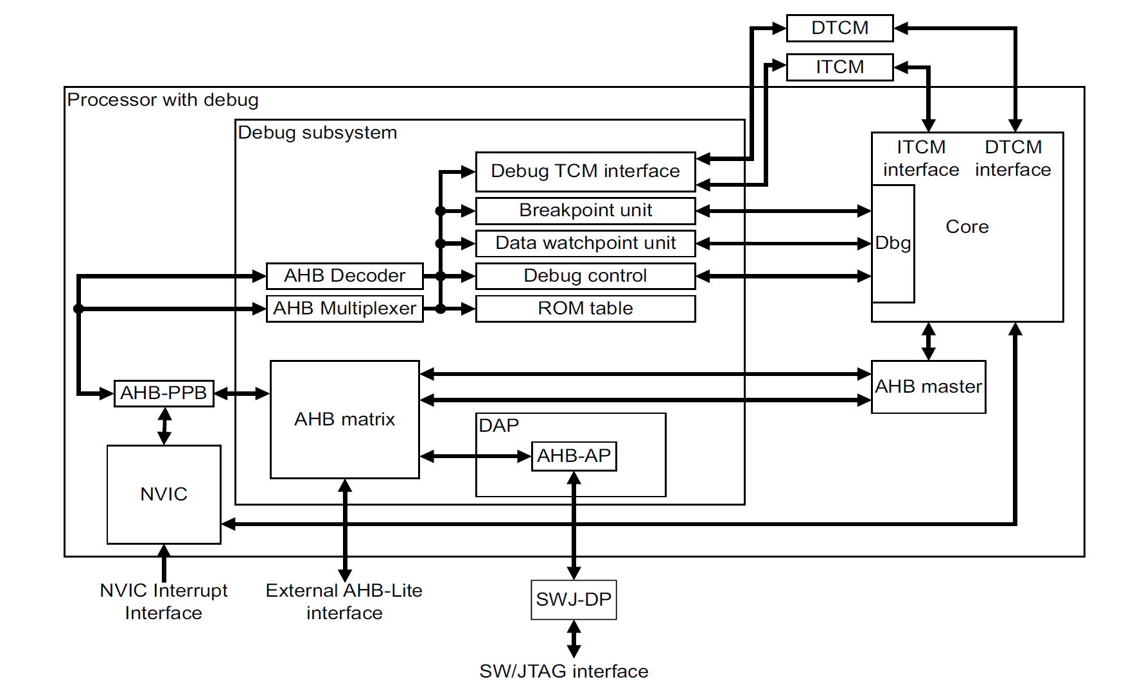
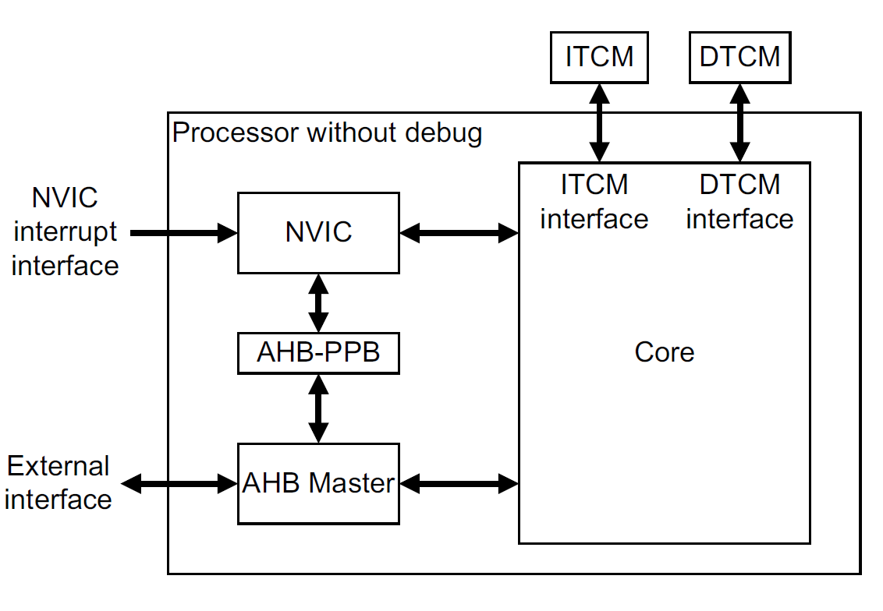
M1 Block Diagram

Slide 49
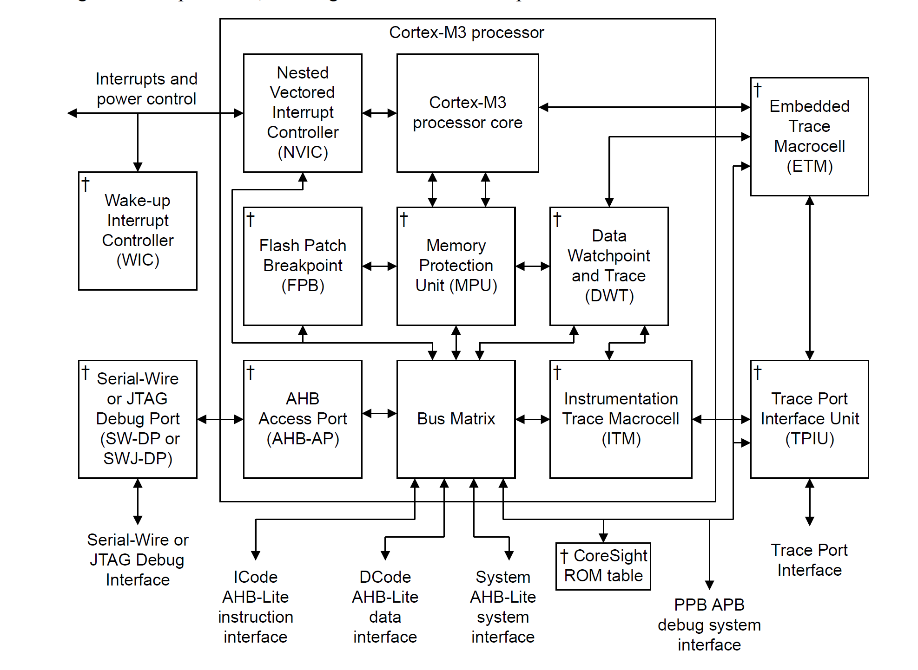
M3 Block Diagram

Slide 50
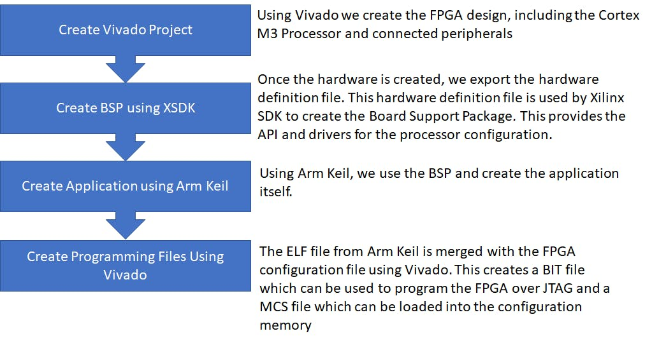
Development Flow
Creating a Cortex-M1 or M3 implementation requires the following development flow:

Slide 51


www.adiuvoengineering.com
adam@adiuvoengineering.com

